Slide 1

BLUE DART
LOGISTICS TRACKING

Slide 2

ABSTRACT
The "Blue dart Logistics Tracking" case study examines the creation of a specialized database system for a logistics company, focusing on efficient shipment tracking and data management. The study outlines the structure of key database tables, such as customers, shipments, couriers, and services, and explains how they are interconnected to support smooth operations.

Slide 3
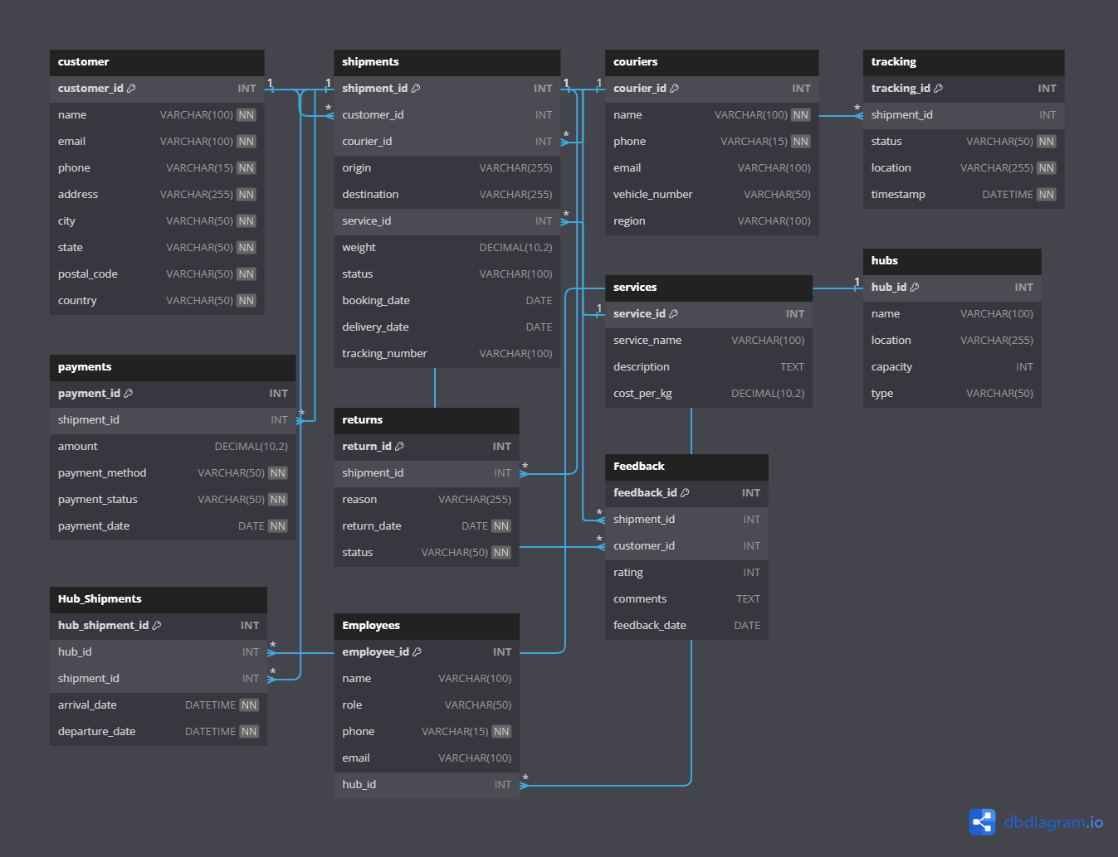
ER-DIAGRAM

Slide 4
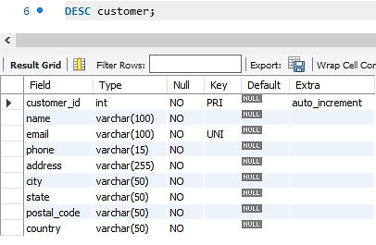
CUSTOMER TABLE
STRUCTURE OF TABLE
Stores information about the customers who use the Blue Dart logistics service. Helps in identifying and managing customer details for shipment bookings, tracking, and feedback.
SYNTAX :- DESC customer;

Slide 5
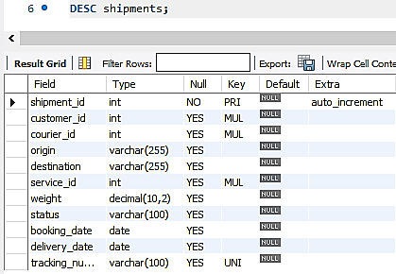
SHIPMENTS TABLE
STRUCTURE OF TABLE
Records all shipment details, including the customer who booked the shipment, the courier handling it, and the service used. Central to the logistics operations, this table tracks every shipment's journey from booking to delivery.
SYNTAX :- DESC shipments;

Slide 6
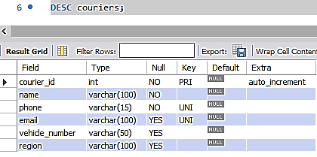
COURIERS TABLE
STRUCTURE OF TABLE
Contains details about the couriers who deliver the shipments. Used to manage and assign couriers to shipments, ensuring efficient and timely deliveries.
SYNTAX :- DESC couriers;

Slide 7
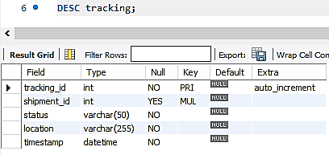
TRACKING TABLE
STRUCTURE OF TABLE
Logs the tracking information for each shipment, detailing its status and location at different points in time. Allows real-time tracking of shipments, providing transparency to both the logistics team and the customers.
SYNTAX :- DESC tracking;

Slide 8
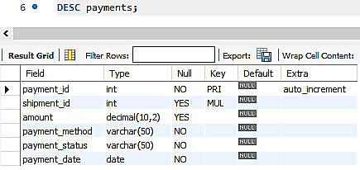
PAYMENTS TABLE
STRUCTURE OF TABLE
Records payment transactions related to shipments. Tracks payment details to ensure all shipments are properly billed and payments are received.
SYNTAX :- DESC payments;

Slide 9
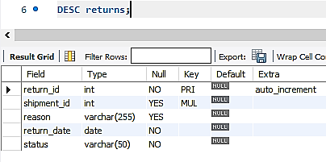
RETURNS TABLE
STRUCTURE OF TABLE
Captures information about shipments that have been returned. Manages and tracks returns, helping the logistics team to handle reverse logistics efficiently.
SYNTAX :- DESC returns;

Slide 10
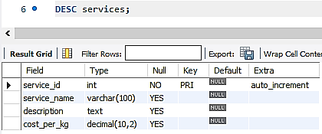
SERVICES TABLE
STRUCTURE OF TABLE
Describes the various logistics services offered, such as standard delivery, express delivery, etc. Allows customers to choose from different service options based on their needs and helps calculate shipment costs.
SYNTAX :- DESC services;

Slide 11
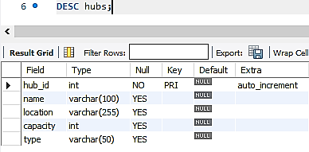
HUBS TABLE
STRUCTURE OF TABLE
Represents the distribution hubs used in the logistics network. Helps in managing the logistics network by tracking where shipments are processed or stored during transit.
SYNTAX :- DESC hubs;

Slide 12
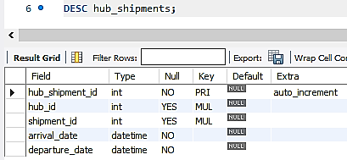
HUB_SHIPMENTS TABLE
STRUCTURE OF TABLE
Tracks shipments as they move through various hubs in the logistics network. Provides a detailed record of shipments as they pass through different hubs, ensuring smooth transitions between locations.
SYNTAX :- DESC hub_shipments;

Slide 13
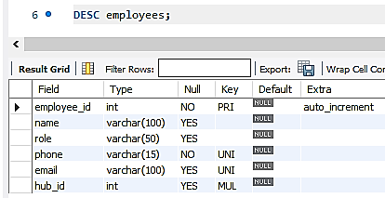
EMPLOYEES TABLE
STRUCTURE OF TABLE
Stores information about the employees working in various hubs or involved in the logistics process. Manages human resources within the logistics network, particularly those stationed at hubs or involved in shipment handling.
SYNTAX :- DESC employees;

Slide 14
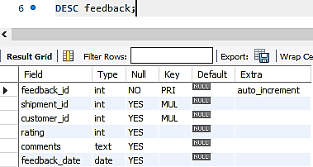
FEEDBACK TABLE
STRUCTURE OF TABLE
Collects customer feedback related to their shipments. Helps monitor customer satisfaction and identify areas for service improvement through direct feedback.
SYNTAX :- DESC feedback;

Slide 15
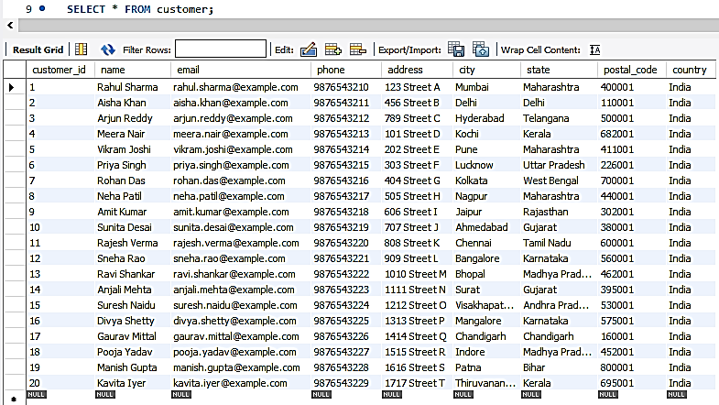
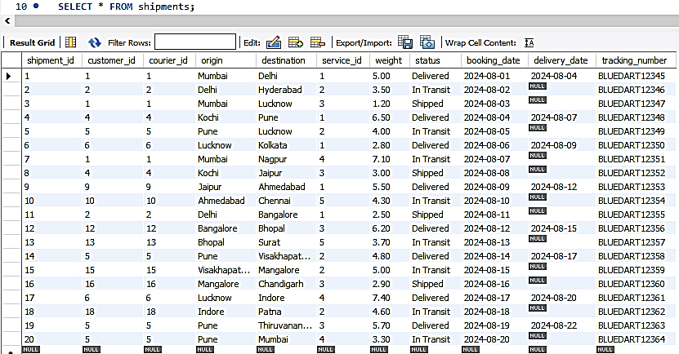
CONTENTS OF TABLE
SELECT * FROM customer;
SELECT * FROM shipments;

Slide 16
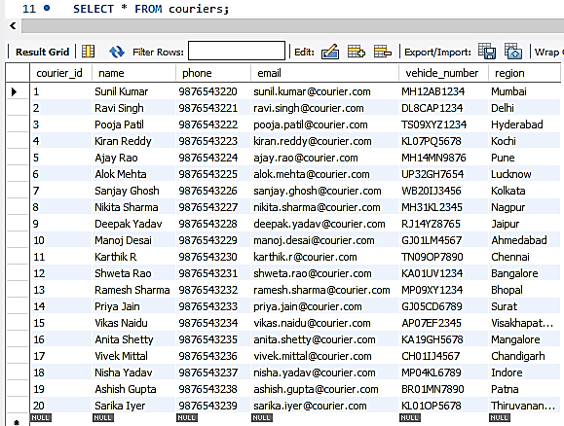
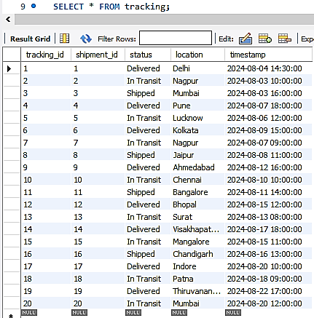
CONTENTS OF TABLE
SELECT * FROM couriers;
SELECT * FROM tracking;

Slide 17
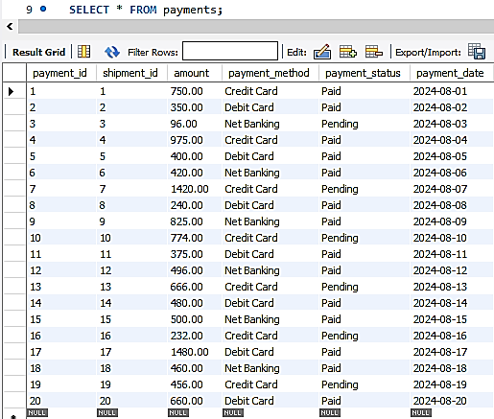
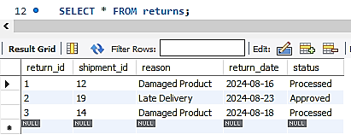
CONTENTS OF TABLE
SELECT * FROM payments;
SELECT * FROM returns;

Slide 18
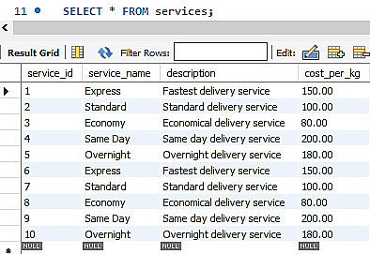
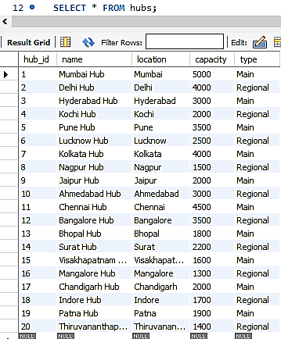
CONTENTS OF TABLE
SELECT * FROM services;
SELECT * FROM hubs;

Slide 19
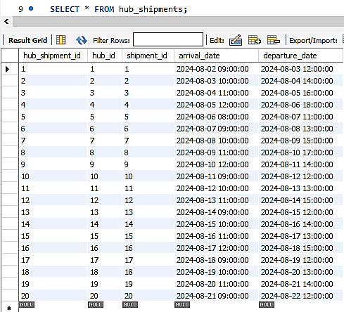
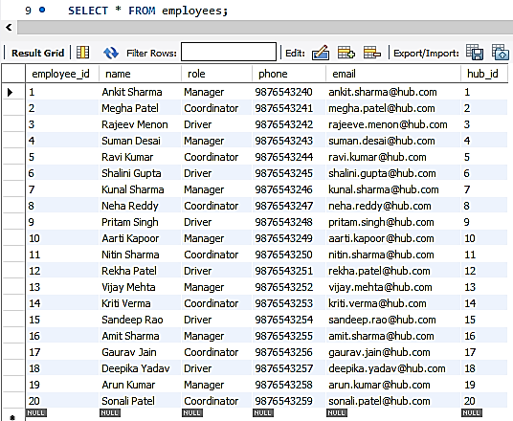
CONTENTS OF TABLE
SELECT * FROM hub_shipments;
SELECT * FROM employees;

Slide 20
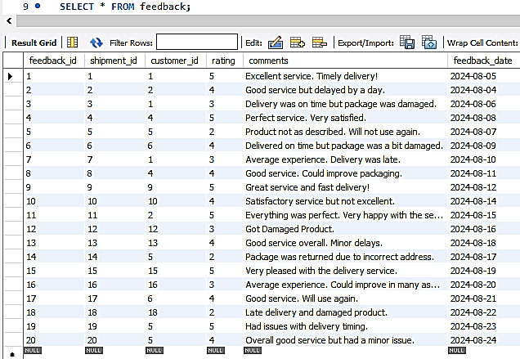
CONTENTS OF TABLE
SELECT * FROM feedback;

Slide 21
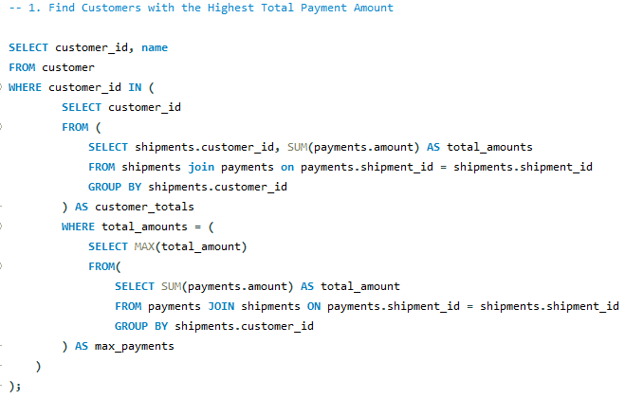
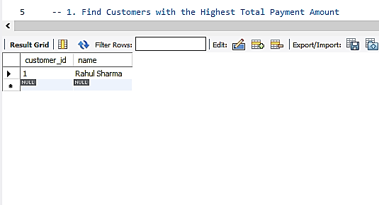
SUBQUERY
Find Customers with the Highest Total Payment Amount.

Slide 22
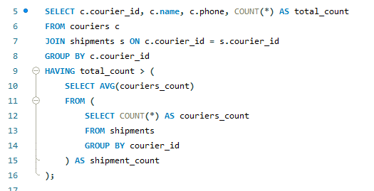
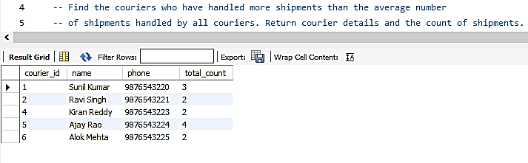
SUBQUERY
Find the couriers who have handled more shipments than the average number -- of shipments handled by all couriers. Return courier details and the count of shipments.

Slide 23
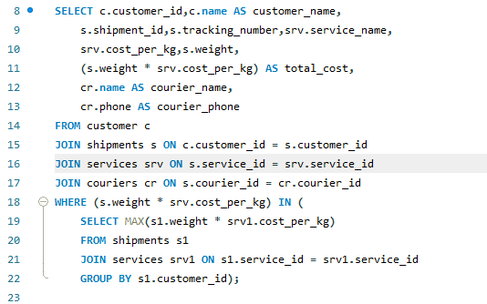
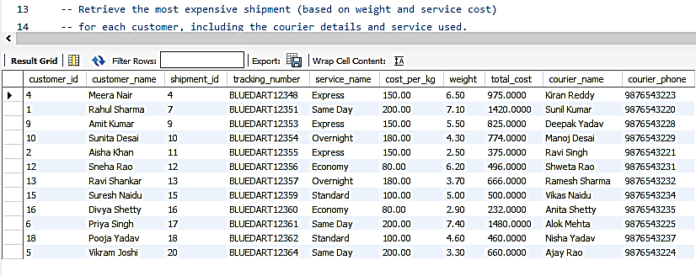
SUBQUERY
Retrieve the most expensive shipment (based on weight and service cost) for each customer, including the courier details and service used.

Slide 24
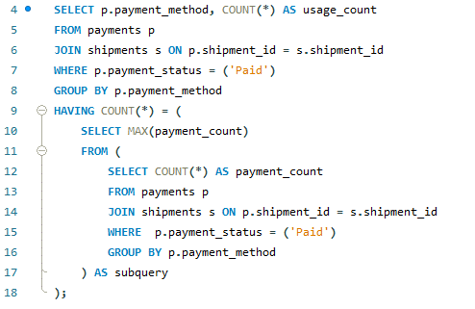
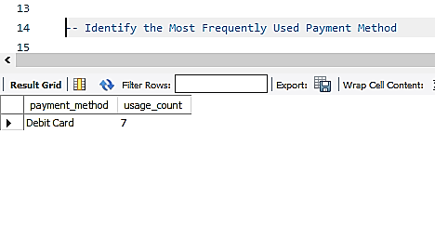
SUBQUERY
Identify the Most Frequently Used Payment Method.

Slide 25
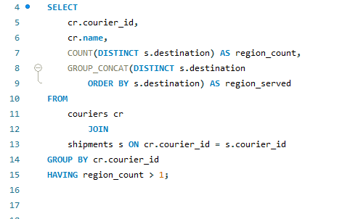
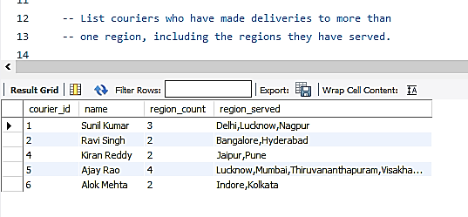
JOINS
List couriers who have made deliveries to more than one region, including the regions they have served.

Slide 26
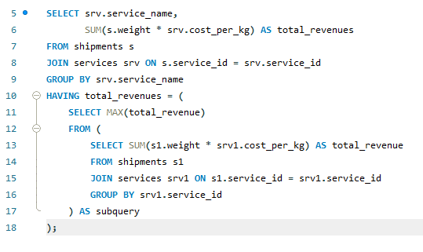
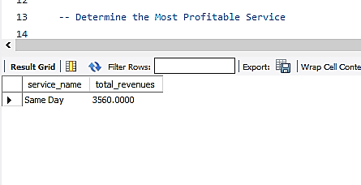
JOINS
Determine the Most Profitable Service.

Slide 27
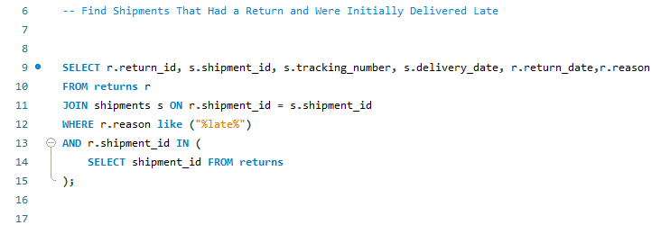
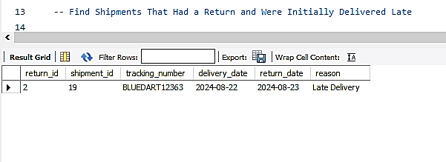
JOINS
Find Shipments That Had a Return and Were Initially Delivered Late

Slide 28
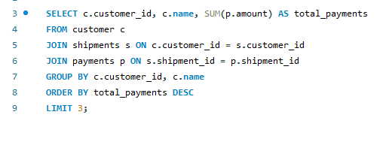
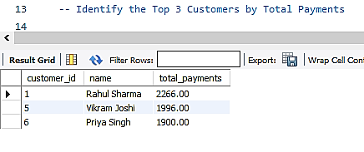
JOINS
Identify the Top 3 Customers by Total Payments.

Slide 29
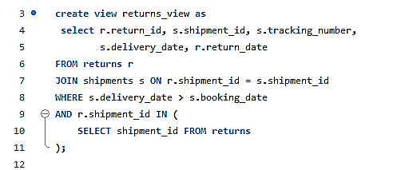
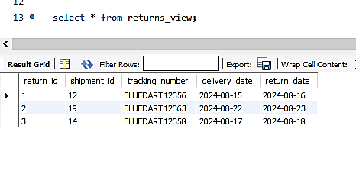
VIEW
Returned Shipments Overview.

Slide 30
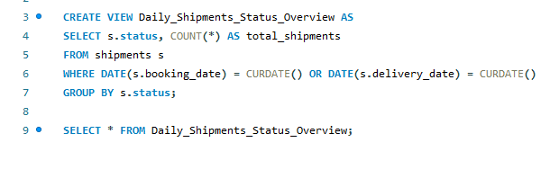
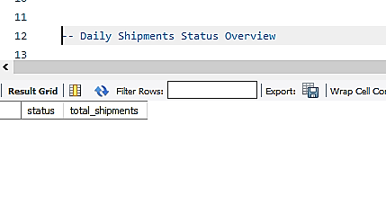
VIEW
Daily Shipments Status Overview.

Slide 31
PREPARED BY
RITESH .R. TIWARI
IT VEDANT
T324

Slide 32
THANK YOU

